Slide 1
ompulsory ollectives ommand aution
©
Intellectual Property Scholars Conference 2013
Professor Matthew Sag

Slide 2
But first a word from my sponsors
To donate to the American Cancer Foundation
Go to
http://matthewsag.com/marathon/
And click on the “donate” link.

Slide 3
Introduction
Relevance:
Webcasting
Book digitization?
Justifications:
Voluntary collectives easy to justify
Compulsory license collectives
Incentives & Efficiency???
Preserving the status quo, Room for new technology
Price control, distributive justice …. {help rights holders? Users?}
Rationale should be reflected in design choices

Slide 4
Institutional Design Issues
Rate-Setting
Information problems
Decision standard
WBWS?, Fairness?, Public Interest?
Monopoly Pricing
1. Rights Holder Exit and Abstention
2. Direct Antitrust Supervision

Slide 5
Principal-Agent Problems
Managerial self-indulgence … graft
Unfair treatment of individuals and groups
Lack of transparency
Mission Creep
Lobbying for expansion of role
Over-claiming of rights
Attempts to undermine alternative market structures (esp. CC and public domain)

Slide 6
Stifling Innovation
Ossify around existing patterns of use
Pandora!
Capturing the compulsory license structure can be used to raise barriers to entry
Overshadowing other policy imperatives
Fair use is more than transaction failure
Tolerated Use enhances social welfare but reduces CRO welfare

Slide 7
Some thoughts about orphan works
1. We should not burden fair use with a compulsory license.
Social benefit > loss of incentive

Slide 8
2. Any compulsory licensure be narrowly tailored
Goals: Allowing for the distribution of orphan works and facilitating the de-orphaning of works.
License fees should be charged on the basis of an estimation of what the rights holder would charge in a competitive market [not based on what a publisher would currently charge for a new similar work].
License fees should be completely refunded after five years.
Could lead to a healthy secondary market.
Judicial supervision has a better track record than agency supervision
DOJ, FTC preferable to the Copyright Office

Slide 9
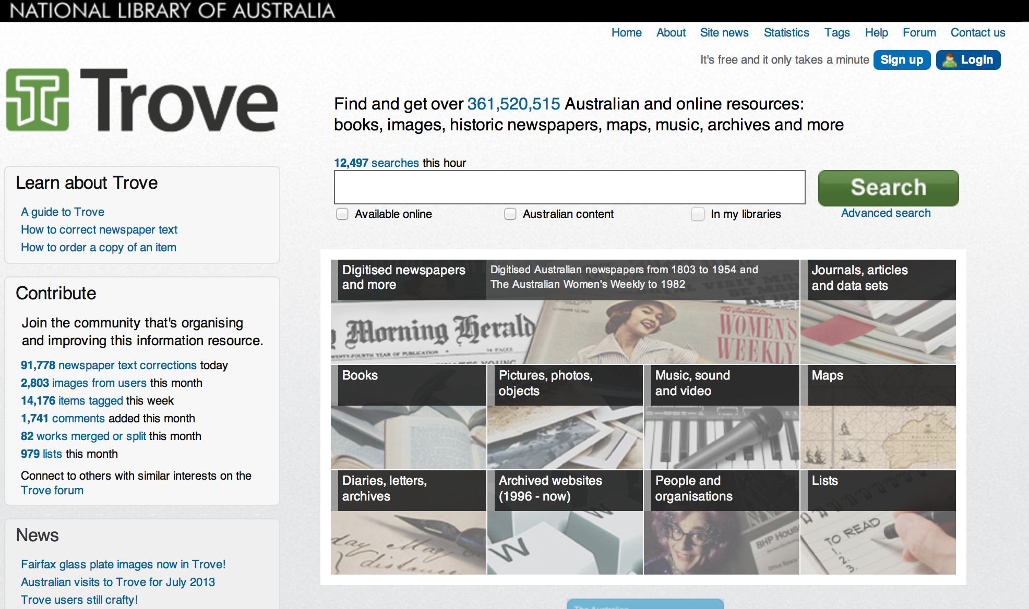
3. We are probably better off without a digitization compulsory license
If you really care about orphan works, fix statutory damages and let people make their own cost-benefit assessment

